Slide 1
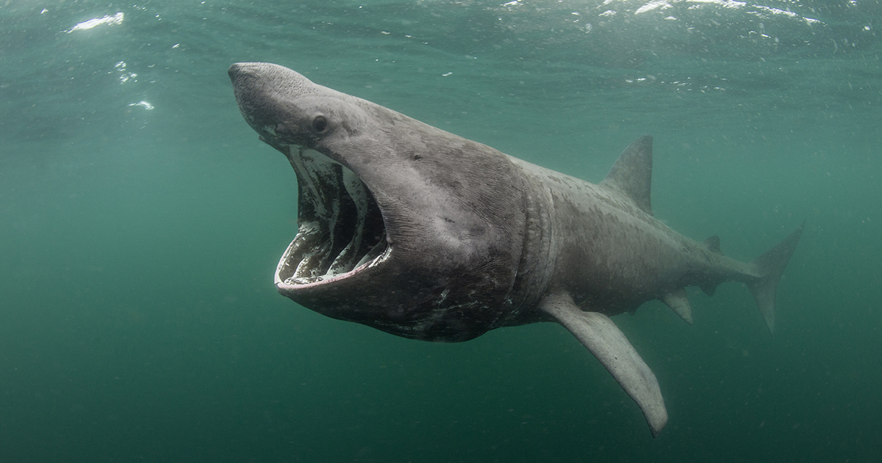
Single season occupancy models

Slide 2
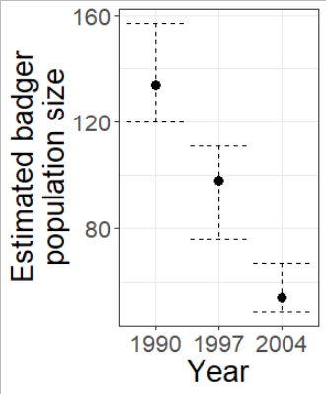
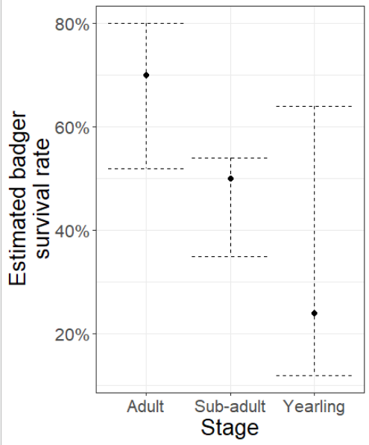
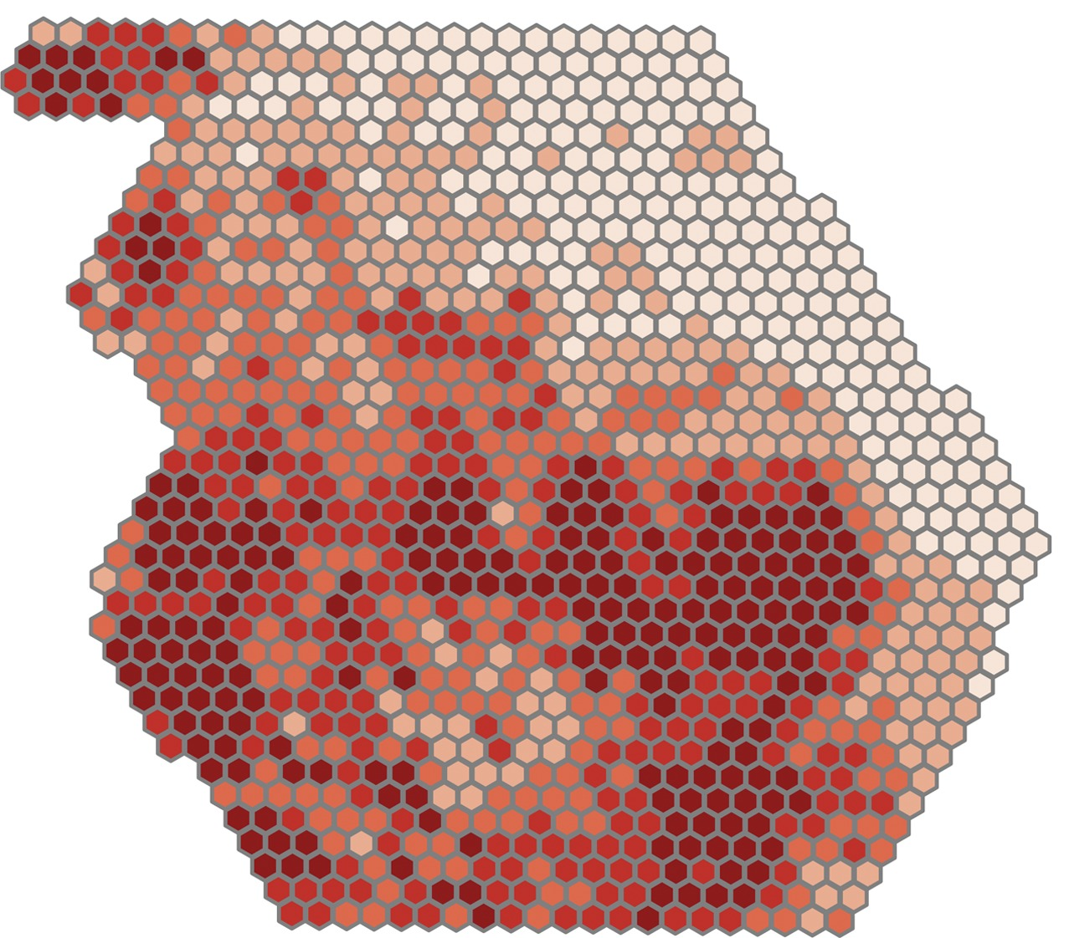

What we’ve done so far
Closed CMR models
Estimate abundance of a single population
Open CMR models
Estimate survival for groups of individuals within a population
Occupancy models
Estimate dynamics of multiple populations (i.e. meta population across sites)
$$logit\left(P_{j}\right)=ln\left(\frac{P_{j}}{1−P_{j}}\right)$$
All use logit link

Slide 3

Why not just do presence-absence surveys?
Traditionally, if biologists want to know a species range, they conduct “presence-absence” surveys across range
Better name would be “detection-nondetection” surveys
Is it fair to say that a nondetection = absence?
Is it fair to assume that you are just as likely to detect a species in a dense mountain forest as you are in a flat grassland?
Ignoring incomplete registration can lead to bias in estimates
Often underestimate occupancy

Slide 4
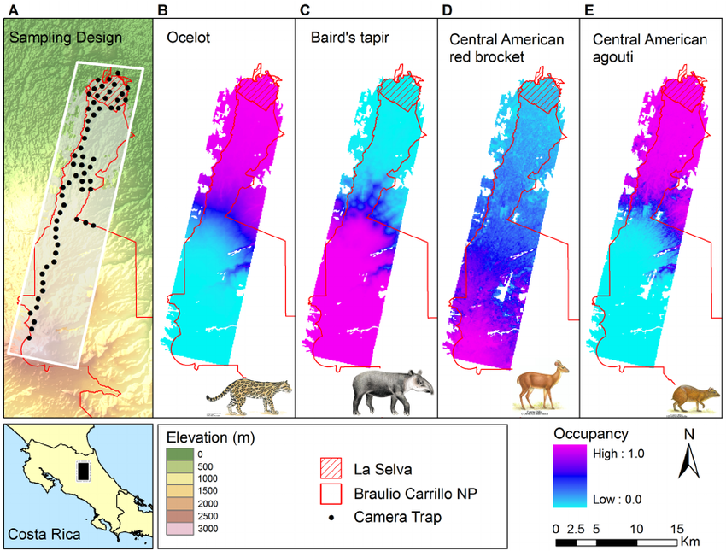
What can you do with occupancy models?
Geographic range
Habitat relationships
Resource selection
Metapopulation dynamics
Large-scale monitoring
Species interactions
Habitat-species dynamics
Epidemiology

Slide 5
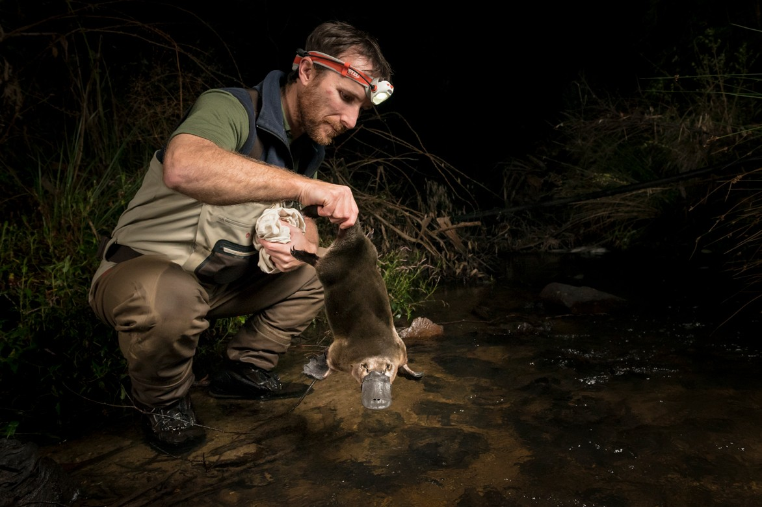
Platypus hunters
Biologists in AUS trying to do research on platypus
Use eDNA to identify if species is present across a variety of sites
What can you do with this information?

Slide 6
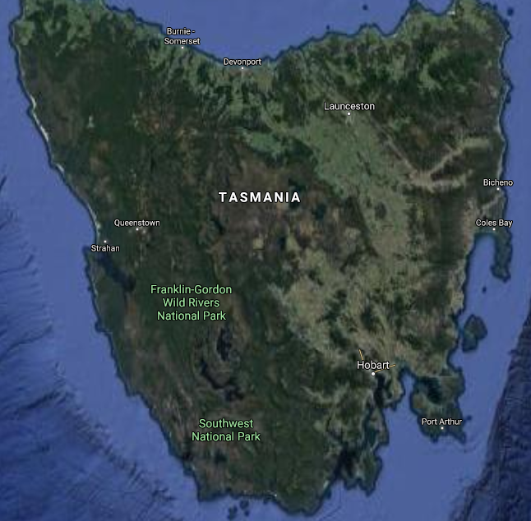
Where the platypus roam
Platypus in Tasmania are the target population
But sampling all is not feasible
Instead opt to collect data from sample populations
In these sample population of sites we may believe that platypus could be present
But it’s not guaranteed
Are these sites always occupied?
Local extinction and subsequent recolonisation is common in nature
Can we figure out what these dynamics are?
What is our detection rate using, e.g., eDNA?

Slide 7
Sampling where the platypus roam
Each sampling period is referred to as a “season”
Think of “field season”
When we sample from the white circled sites
We assume that the site is closed to changes
If platypus in site A are present in season 1
Site A will be occupied for the entirety of season 1
But the site can go extinct in season 2
(Does not mean that the same individuals are present)
Must have multiple surveys within a season
Can be multiple visits or multiple observers
Can be for a single season or multiple season

Slide 8
Reminder; Robust design models
In CMR, Robust design has multiple trapping sessions per time
A single season
Alive
Dead
Seen
Not seen
Multiple surveys in each season

Slide 9
Closed CMR and single-season occupancy models are almost the same thing
But what changes?

Slide 10

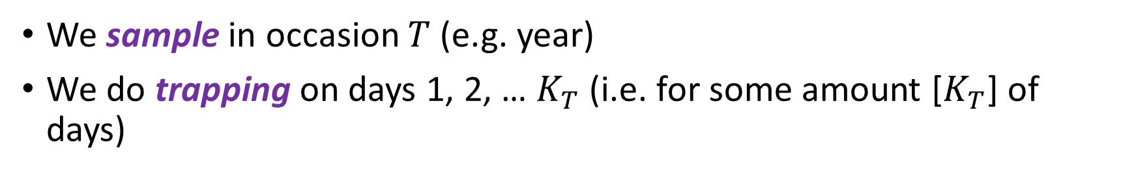

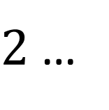

Conceptual sampling framework for closed CMR
$$T$$
$$1$$
$2$ …
$$K_{T}$$
Closure at the population level
We sample in occasion $T$ (e.g. year)
We do trapping on days 1, 2, … $K_{T}$ (i.e. for some amount [$K_{T}$] of days)

Slide 11

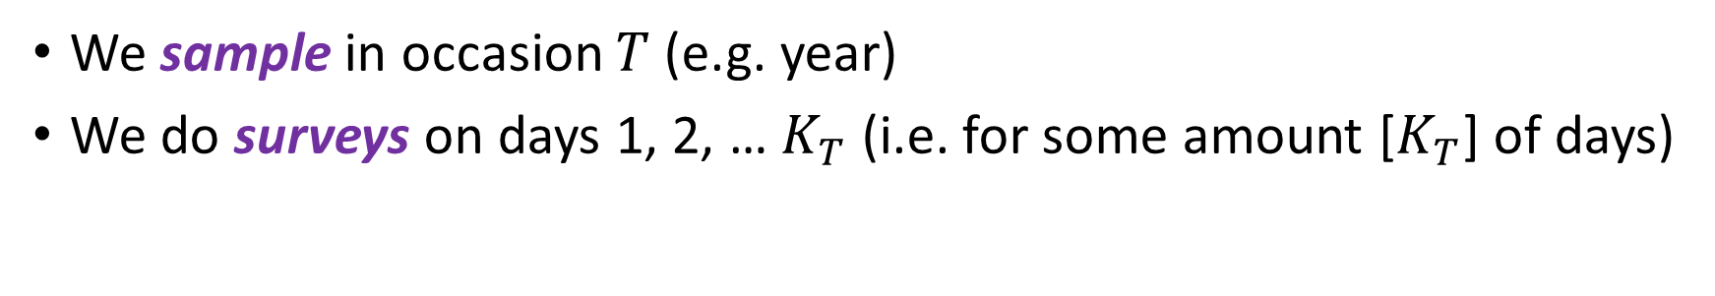
For single-season occupancy models
$$T$$
$$1$$
$2$ …
$$K_{T}$$
Closure at the population level
Closure at the species level
We sample in occasion $T$ (e.g. year)
We do surveys on days 1, 2, … $K_{T}$ (i.e. for some amount [$K_{T}$] of days)
We sample in occasion $T$ (e.g. year)
We do trapping on days 1, 2, … $K_{T}$ (i.e. for some amount [$K_{T}$] of days)

Slide 12
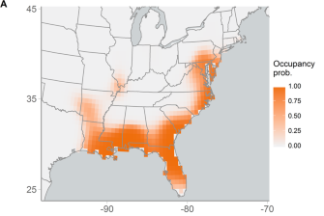
What does the data look like?
For closed CMR
A capture history of 110 meant;
CAPTURED CAPTURED NOT CAPTURED
ALIVE ALIVE ALIVE (because of closure)
For single-season occupancy models
A detection history of 110 means;
DETECTED DETECTED NOTDETECTED
PRESENT PRESENT PRESENT (because of closure)
So data looks identical
110011
011011
010111
(with one caveat, more later)

Slide 13
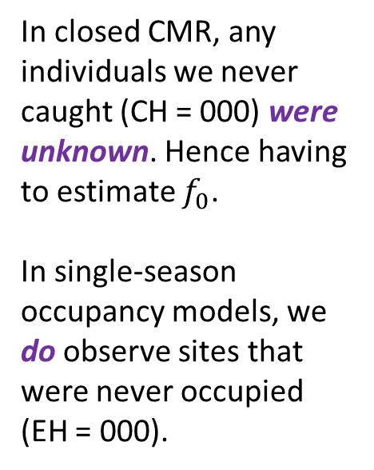
State-space in occupancy models
Observation process
(i.e. what you observe in the field)
101
000
100
000
In closed CMR, any individuals we never caught (CH = 000) were unknown. Hence having to estimate $f_{0}$.
In single-season occupancy models, we do observe sites that were never occupied (EH = 000).
111
000
State process
(i.e. what the biological reality is)

Slide 14
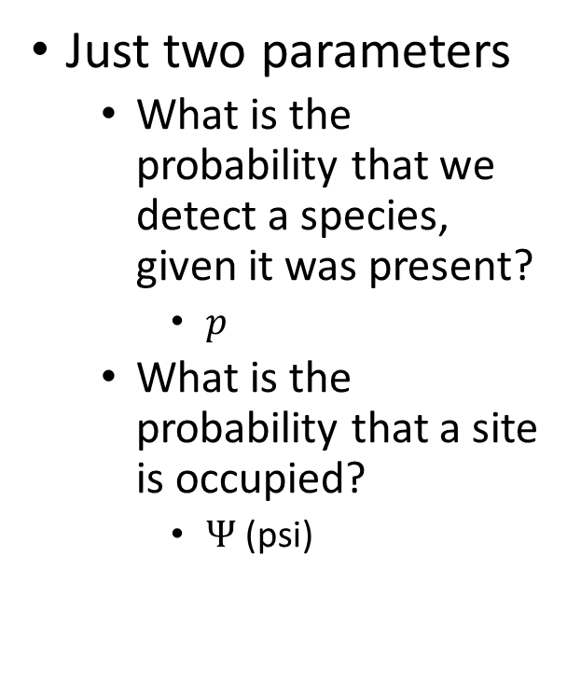
Parameters in single-season occupancy models
Just two parameters
What is the probability that we detect a species, given it was present?
$\text{p}$
What is the probability that a site is occupied?
$Ψ$ (psi)
101
000
100
000
111
000

Slide 15
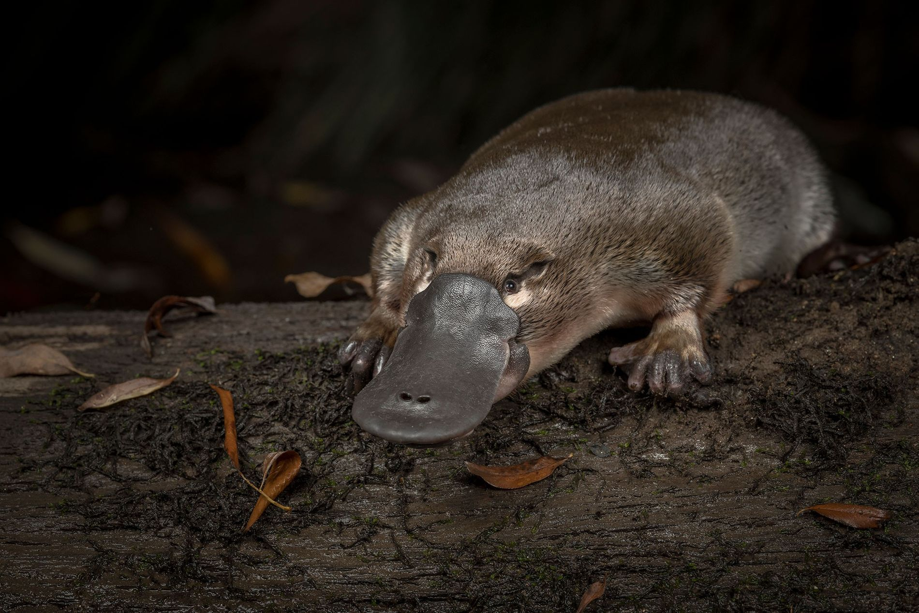
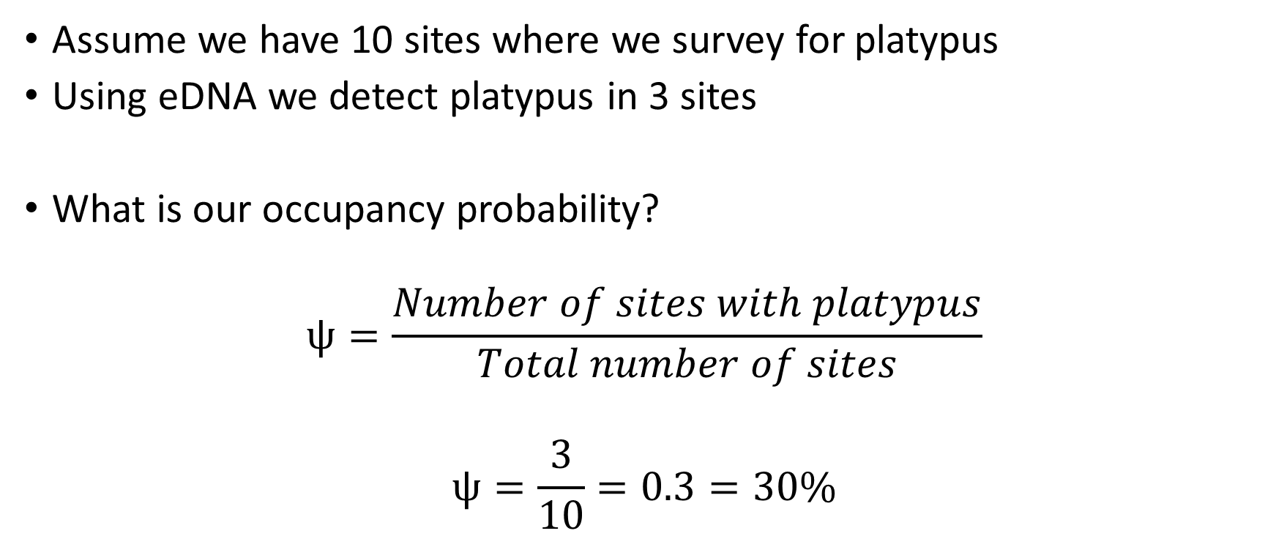
How do single-season occupancy models work?
Assume we have 10 sites where we survey for platypus
Using eDNA we detect platypus in 3 sites
What is our occupancy probability?
$$ψ=\frac{Number of sites with platypus}{Total number of sites}$$
$$ψ=\frac{3}{10}=0.3=30\%$$
What is the problem with this?

Slide 16
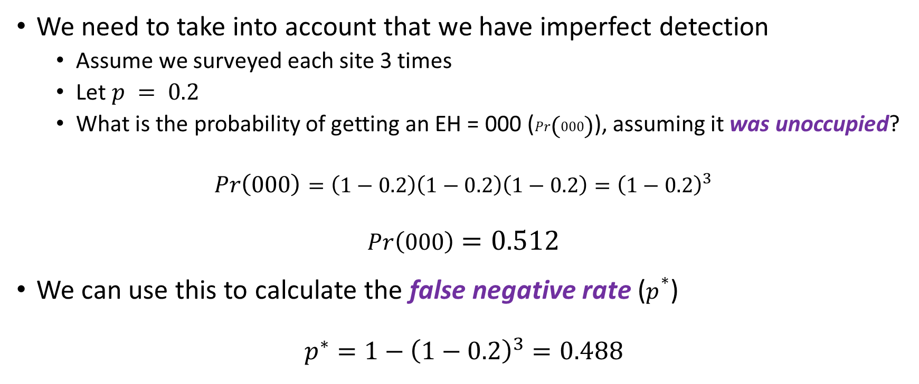
False negatives
We need to take into account that we have imperfect detection
Assume we surveyed each site 3 times
Let $p = 0.2$
What is the probability of getting an EH = 000 ($Pr\left(000\right)$), assuming it was unoccupied?
$$Pr\left(000\right)=\left(1−0.2\right)\left(1−0.2\right)\left(1−0.2\right)={\left(1−0.2\right)}^{3}$$
$$Pr\left(000\right)=0.512$$
We can use this to calculate the false negative rate ($p^{∗}$)
$$p^{∗}=1−{\left(1−0.2\right)}^{3}=0.488$$
True negative rate

Slide 17
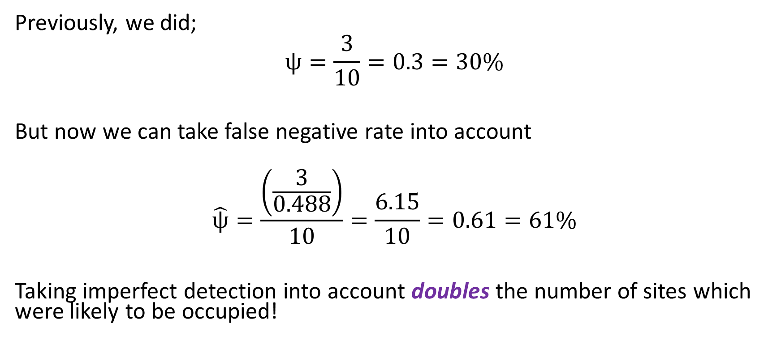
Accounting for imperfect detection
Previously, we did;
$$ψ=\frac{3}{10}=0.3=30\%$$
But now we can take false negative rate into account
$$\hat{ψ}=\frac{\left(\frac{3}{0.488}\right)}{10}=\frac{6.15}{10}=0.61=61\%$$
Taking imperfect detection into account doubles the number of sites which were likely to be occupied!

Slide 18
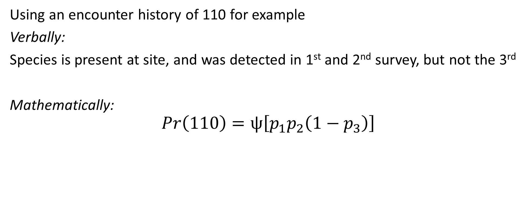

Bringing $ψ$ and $p$ together
Using an encounter history of 110 for example
Verbally:
Species is present at site, and was detected in 1st and 2nd survey, but not the 3rd
Mathematically:
$$Pr\left(110\right)=ψ\left[p_{1}p_{2}\left(1−p_{3}\right)\right]$$

Slide 19
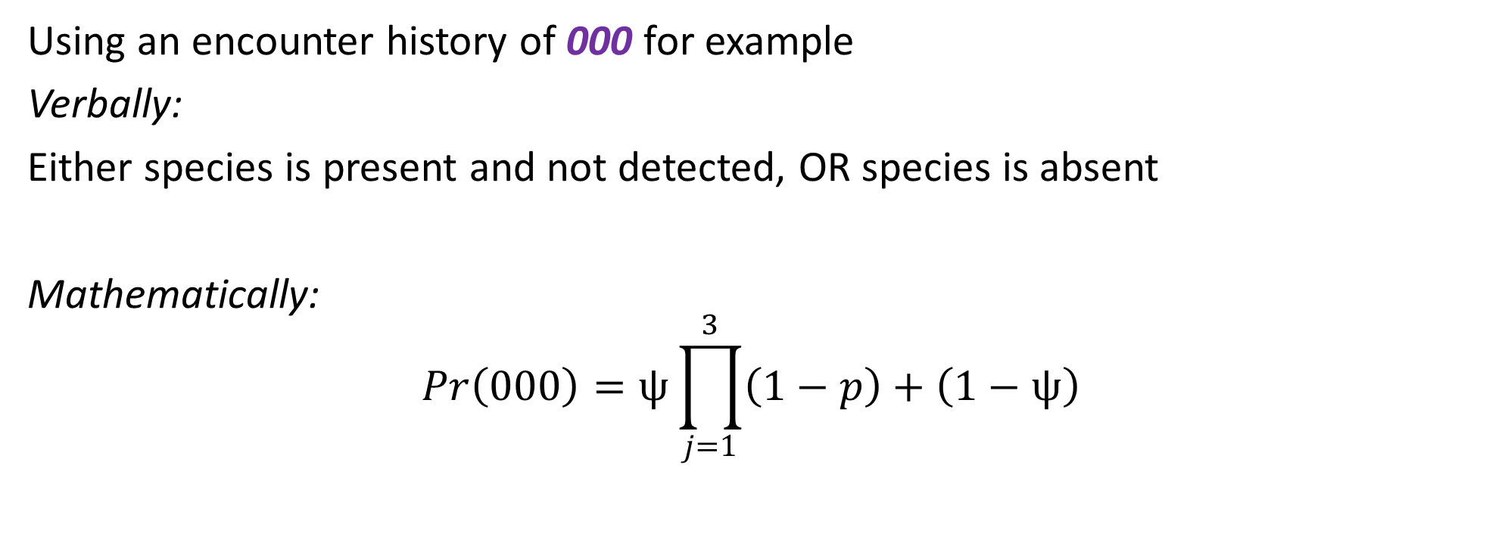
Bringing $ψ$ and $p$ together
Using an encounter history of 000 for example
Verbally:
Either species is present and not detected, OR species is absent
Mathematically:
$$Pr\left(000\right)=ψ\prod_{j=1}^{3}{\left(1−p\right)}+\left(1−ψ\right)$$

Slide 20
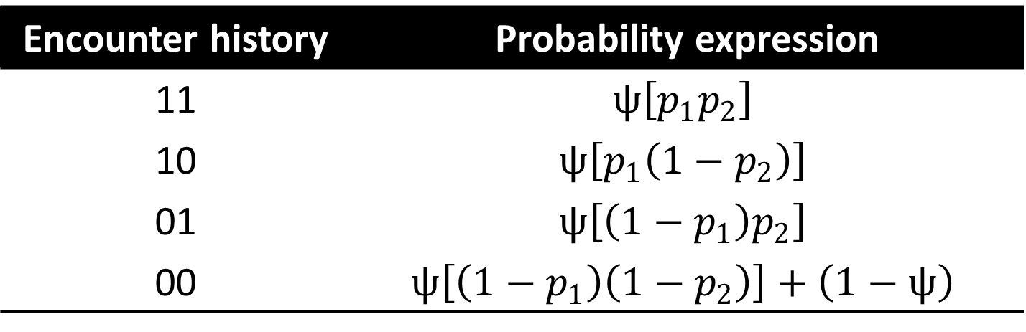
Bringing $ψ$ and $p$ together
To figure out the probabilities for each encounter history
2 surveys for simplicity
Encounter history | Probability expression
11 | $$ψ\left[p_{1}p_{2}\right]$$
10 | $$ψ\left[p_{1}\left(1−p_{2}\right)\right]$$
01 | $$ψ\left[\left(1−p_{1}\right)p_{2}\right]$$
00 | $$ψ\left[\left(1−p_{1}\right)\left(1−p_{2}\right)\right]+\left(1−ψ\right)$$

Slide 21
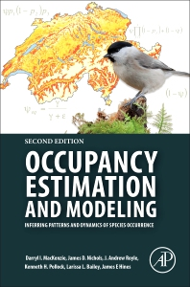
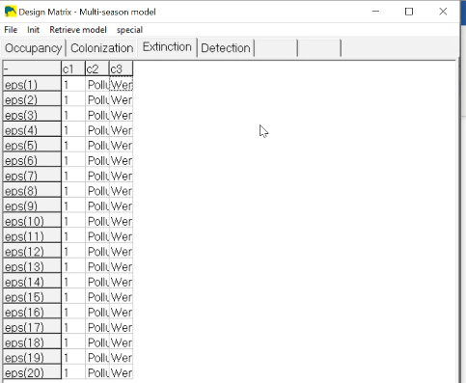
Presence software
Made by many of the same folk who made MARK
Works exclusively with the design matrix

Slide 22
tl;dr
Occupancy models are used for present-absent survey data
But crucially take into account imperfect detection
Incorporate both
the state process
(i.e. the biological reality)
And the observation process
(i.e. what we observe)
Reports how likely a site is to be occupied
101
000
100
000
111
000

